Slide 1

MEMBERS KEERTHANA P G KEERTHIVASAN S LOGESHWARAN K PRAGADEESHWAR D II YEAR, B.E ECE SRI KRISHNA COLLEGE OF TECHNOLOGY
Title : IoT based smart agriculture

Slide 2
Abstract
The world is changing with time and so is agriculture. IoT Smart technology enables new digital agriculture. Smart agriculture, based on IoT technologies, is envisioned to enable producers and farmers to reduce waste and improve productivity by optimizing water management to boost the efficiency of plants.
This merging of electronics in agriculture is helping farmers and people who manage gardens. We can do smart agriculture by incorporating IoT in agriculture. The usage of sensors like temperature sensors, soil moisture level sensors and also we can use lot of sensors to monitor.
IoT-based Smart Farming gives better control to the farmers for their livestock, growing crops, cutting costs, and resources. The most common challenge for the Internet of Things in agriculture is connectivity. Every area doesn’t have proper internet connectivity.

Slide 3
Introduction
As human populations expand and available land for food production diminishes, there's an increasing urgency to adopt sustainable farming practices. Organic farming, emphasizing ecosystem health and biodiversity, emerges as a viable alternative to conventional methods reliant on synthetic inputs.
This paper undertakes a comparative analysis between organic and conventional farming, aiming to determine the most effective approach for sustainable crop production. Through meticulous examination of long-term research findings, it seeks to shed light on the ongoing debate surrounding agricultural practices and their implications for food security and environmental sustainability.

Slide 4
History of Agriculture
Agriculture, dating back to 10,000 B.C.E., has been pivotal in human society's progress, providing the majority of the world's food and resources. Early practices of selective breeding boosted crop yields, facilitating settlement growth. Over time, agriculture has evolved, catering to diverse needs and climates worldwide.
While early farming methods focused on local conditions, innovations like crop rotation and intercropping have emerged to sustain soil health and long-term productivity. Today, agriculture remains essential, supplying food, fabrics, construction materials, and driving continuous advancements in farming practices.

Slide 5
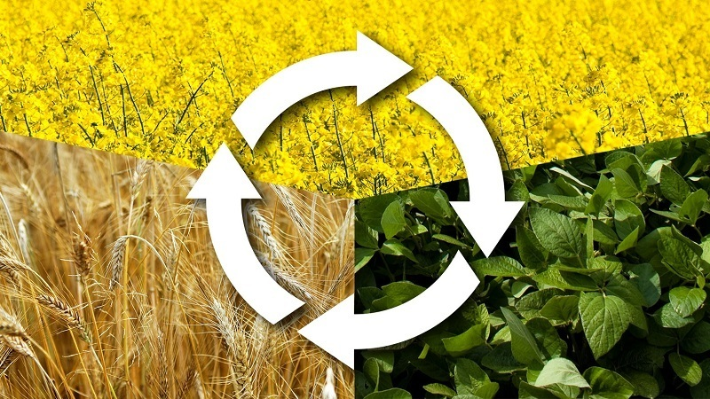
Crop rotation technique
Crop rotation is defined as growing a different crop on a given land area every growing/planting cycle and season. Crops are rotated for different reasons, but one reason is to break disease and pest cycles. It reduces reliance on one set of nutrients, pest and weed pressure, and the probability of developing resistant pests and weeds.
Crop rotation represents one of the most efficient alternatives to pesticide. For example, legumes plants such as peas can be grown in late spring and will stop growing in the summer months, brassica can be grown in the autumn season which is healthy and nutrient-rich.

Slide 6
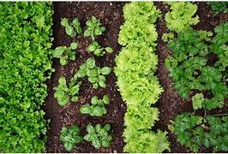
Intercropping technique
The intercropping system employs growing several species in-between each other during the same season, alternatively to monoculture farming. Intercropping practices differ in arrangement, sowing time, and plant combinations. Thus, perennials can grow together with other perennials or annuals, and annuals can grow with other annuals.
Intercropping involves a certain arrangement of plants that gives the basis for its classification. Thus, intercropping types fall into the row, strip, relay, temporal, mixed, guard, alley, trap, repellent, and push-pull cropping among others.

Slide 7
Conventional agricultural practices
Conventional agriculture is a broad term that has a number of definitions, but a crop can be classified as conventional if synthetic chemicals are used to maintain the plants. A significant amount of chemical and energy input is required in conventional agriculture to produce the highest possible yield of crops.
Of all the innovations in agriculture, arguably none has been more influential than synthetic fertilizers—chemicals manufactured using a technique that transforms nitrogen in the atmosphere into a form that can be applied to crops (ammonia). First introduced in the early 1900s, synthetic fertilizers dramatically increased crop yields (though not without consequences) and have been credited with providing the lion’s share of the world’s food over the 20th century. The use of these and other chemicals has become a hallmark of industrial agriculture

Slide 8
New era of farming
Smart Farming utilizes data from various sources to manage farm activities efficiently. It employs IoT hardware and SaaS software to capture and analyze data, providing actionable insights for both pre and post-harvest operations.
IoT technology in agriculture involves sensors, drones, and robots connected via the internet, automating tasks and gathering data to increase efficiency and predictability. With labor shortages globally, agriculture automation and Agribots are gaining traction.
IoT-based remote sensing employs sensors like weather stations to monitor crops for changes in environmental conditions, aiding in crop selection and irrigation management based on soil quality and weather patterns.

Slide 9
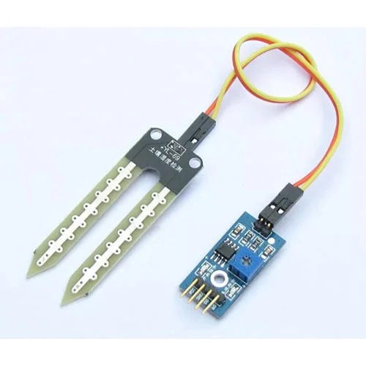
Basic components of smart farming
SOIL MOISTURE SENSOR
The Soil Moisture Sensor uses capacitance to measure the dielectric permittivity of the surrounding medium. In soil, dielectric permittivity is a function of the water content.
The sensor creates a voltage proportional to the dielectric permittivity, and therefore the water content of the soil.

Slide 10
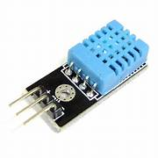
Components..
DHT11 TEMPERATURE-HUMIDITY SENSOR
The DHT11 is a basic, ultra low-cost digital temperature and humidity sensor. It uses a capacitive humidity sensor and a thermistor to measure the surrounding air and spits out a digital signal on the data pin (no analog input pins are needed).
It’s fairly simple to use but requires careful timing to grab data.We will use this sensor to measure the air temperature and humidity

Slide 11
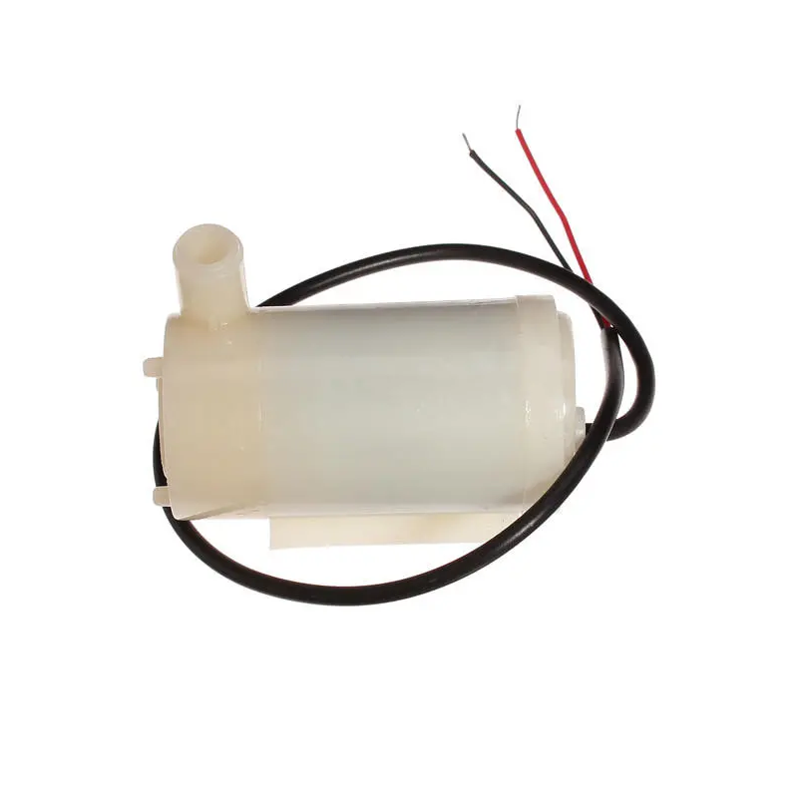
Components..
DC 3-6V MICRO SUBMERSIBLE MINI WATER PUMP
DC 3-6 V Mini Micro Submersible Water Pump is a low-cost, small-size Submersible Pump Motor that can be operated from a 2.5 ~ 6V power supply. It can take up to 120 liters per hour with a very low current consumption of 220MA.
A mini submersible water pump is a centrifugal water pump, which means that it uses a motor to power an impeller that is designed to rotate and push water outwards.

Slide 12
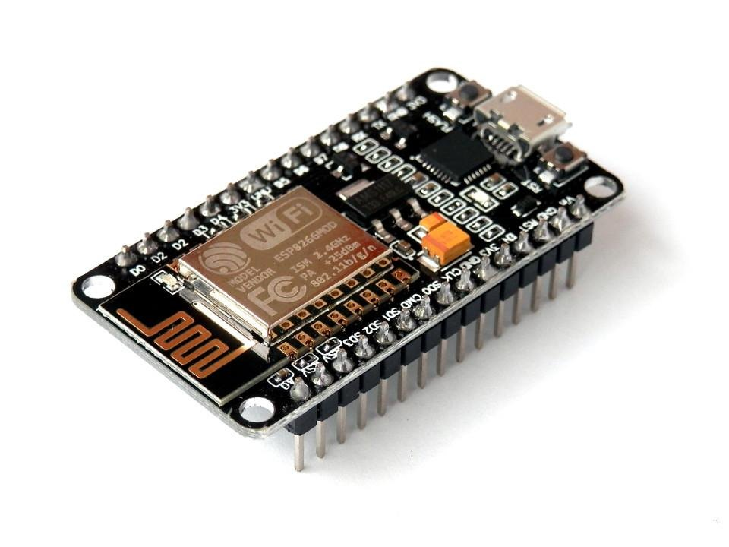
Components..
NODE MCU
Node MCU is an open-source platform based on ESP8266 which can connect objects and let data transfer using the Wi-Fi protocol.
In addition, by providing some of the most important features of microcontrollers such as GPIO, PWM, ADC, etc, it can solve many of the project's needs alone.

Slide 13
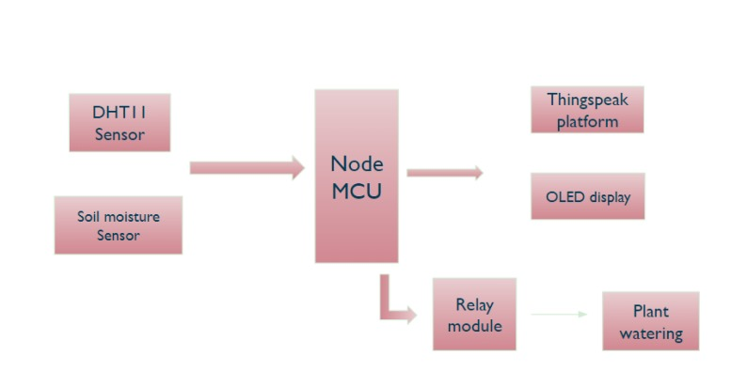
Working process of data transmission

Slide 14
Benefits
IoT agricultural solutions consist of multiple monitoring, controlling, and tracking applications that measure several types of variables such as air monitoring, temperature monitoring, humidity monitoring, soil monitoring, water monitoring, fertilization, pest control, illumination control, and location tracking.
The selected mainstream application domains in this SLR are monitoring, tracking, and controlling IoT agricultural solutions consist of multiple monitoring, controlling, and tracking applications that measure several types of variables such as air monitoring, temperature monitoring, humidity monitoring, soil monitoring, water monitoring, fertilization, pest control, illumination control, and location tracking.
The selected mainstream application domains in this SLR are monitoring, tracking, and controlling

Slide 15
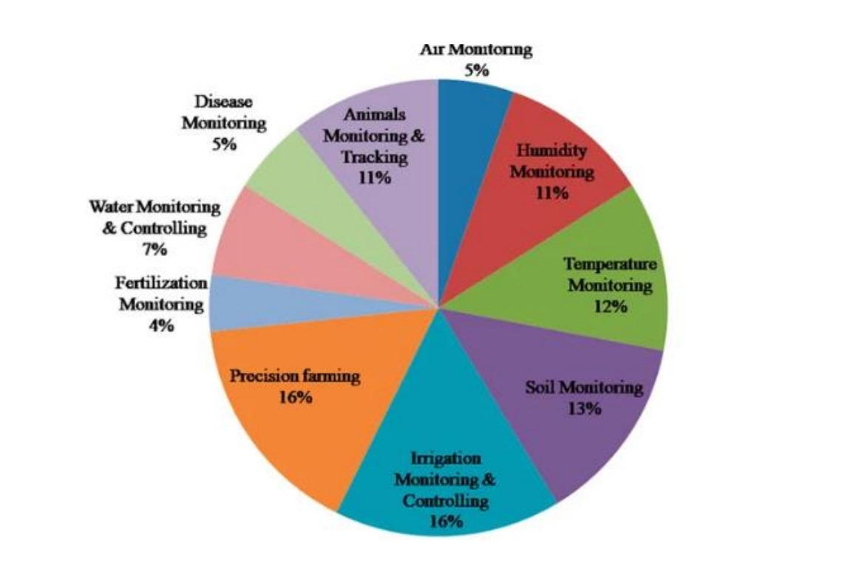
Graphical representation

Slide 16
Conclusion
In conclusion, sustainable agriculture emerges as the optimal solution for managing population growth, yet its global adoption faces challenges due to varying climate conditions. Smart farming outperforms conventional methods in precision and efficiency. Data storage, crucial for predictive analysis, has transitioned to cloud-based systems, enabling easy access and accuracy in detecting weather patterns, pests, crop yield, and profits. Efficient use of resources like water, fuel, and soil remains paramount for sustaining the world's population amidst growing limitations.

